Slide 1
Hurtownie Danych
#01 Wprowadzenie

Slide 2
Business Intelligence

Slide 3
Business Intelligence
[1] proces przekształcania danych w informacje, a informacji w wiedzę, która może być wykorzystana do zwiększenia konkurencyjności przedsiębiorstwa
[2] to infrastruktura technologiczna pozwalająca na uzyskanie maksymalnej korzyści z dostępnych informacji w celu ulepszenia procesu biznesowego. W skład tej infrastruktury wchodzą: rozwiązania softwarowe do pozyskiwania, czyszczenia, integracji, analizowania i udostępniania danych, w sposób pozwalający na podejmowanie szybkich i trafnych decyzji.
[3] to rodzaj systemów informatycznych przekształcających stosy surowych danych w czytelne informacje, które zamieniane są później w wiedzę wspierającą podejmowanie decyzji i świadome analizowanie działań w firmie.
[4] Business intelligence (BI) is a technology-driven process for analyzing data and presenting actionable information to help executives, managers and other corporate end users make informed business decisions.

Slide 4
Business Intelligence
DANE
INFORMACJA
WIEDZA

Slide 5
Raportowanie z systemu źródłowego
Problemy:
Zestawienie z informacjami z innych systemów
Dane historyczne
Stan na konkretną datę/godzinę
Układ bazy (Normalizacja)
Automatyzacja
Raportowanie masowe
Blokowanie systemów
Obciążenie systemów
Proste zestawienia, Informacja a nie wiedza
Raport sprzedażowy
…
…
…
Sales DB
SQL

Slide 6
Business Intelligence
Business Intelligence Maturity Levels
Unorganized
Operational Reports
Management Dashboards
Self Servie Analytics
Data Driven Predictions
Actionable Insights

Slide 7
Business Intelligence
ERP
Analiza
…
…
…
raport
raport
CRM
raport
Magia
HR
Finance
Sales
korekta
korekta
korekta

Slide 8
Hurtownia Danych

Slide 9
Hurtownia Danych
Bill Inmon
„A Data Warehouse is a subject oriented, integrated, nonvolatile, and time variant collection of data in support of management’s decisions”
Ralph Kimball
„A data warehouse is a copy of transaction data specifically structured for query and analysis”

Slide 10
Inmon’s top-down approach (1)
Inmon defines a data warehouse as a centralised repository for the entire enterprise. A data warehouse stores the “atomic” data at the lowest level of detail. Dimensional data marts are created only after the complete data warehouse has been created. Thus, the data warehouse is at the centre of the corporate information factory (CIF), which provides a logical framework for delivering business intelligence.

Slide 11
Inmon’s top-down approach (2)
Subject Oriented (zorientowana tematycznie)
Data warehouses are designed to help you analyze data. For example, to learn more about your company's sales data, you can build a warehouse that concentrates on sales. Using this warehouse, you can answer questions like "Who was our best customer for this item last year?" This ability to define a data warehouse by subject matter, sales in this case, makes the data warehouse subject oriented.
Integrated (zintegrowana)
Integration is closely related to subject orientation. Data warehouses must put data from disparate sources into a consistent format. They must resolve such problems as naming conflicts and inconsistencies among units of measure. When they achieve this, they are said to be integrated.

Slide 12
Inmon’s top-down approach (3)
Nonvolatile (nieulotna)
Nonvolatile means that, once entered into the warehouse, data should not change. This is logical because the purpose of a warehouse is to enable you to analyze what has occurred.
Time Variant (zmienny czasowo)
In order to discover trends in business, analysts need large amounts of data. This is very much in contrast to online transaction processing (OLTP) systems, where performance requirements demand that historical data be moved to an archive. A data warehouse's focus on change over time is what is meant by the term time variant.

Slide 13
Kimball’s bottom-up approach (1)
Keeping in mind the most important business aspects or departments, data marts are created first. These provide a thin view into the organisational data and, as and when required, these can be combined into a larger data warehouse. Kimball defines data warehouse as “a copy of transaction data specifically structured for query and analysis”.
Kimball’s data warehousing architecture is also known as data warehouse bus (BUS). Dimensional modelling focuses on ease of end-user accessibility and provides a high level of performance to the data warehouse.

Slide 14
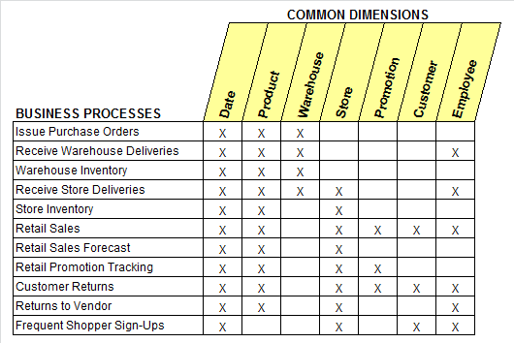
Kimball’s bottom-up approach (2)

Slide 15
Hurtownia Danych
Całościowy, usystematyzowany widok danych w organizacji.
Integracja danych z wielu systemów wewnętrznych (ERP, CRM, HR, Finanse, Sprzedaż).
Integracja danych wewnętrznych (systemy organizacji) i zewnętrznych (np. GUS).
Jakość danych (DQM – Data Quality Management).
Dane przechowywane w spójny, zorganizowany i jednolity sposób.
Dostęp do danych bieżących i historycznych w jednym miejscu.
Optymalizacja pracy.
Zaawansowane analizy bez obciążenia systemów źródłowych.
Struktura HD ułatwiająca zrozumienie struktury organizacji.
Struktura HD zoptymalizowana pod kątem zapytań analitycznych na dużych wolumenach danych.

Slide 16
OLTP vs. OLAP
 | OLTP System | OLAP System
 | Online Transaction Processing | Online Analytical Processing
 | (Operational System) | (Data Warehouse)
źródło danych | dane operacyjne | dane skonsolidowane, pobierane z systemów OLTP, dane zewnętrzne (np. GUS), pliki xlsx/csv (korekty, analizy, wyliczenia)
cel | obsługa procesów biznesowych | analiza, planowanie, wspomaganie podejmowania decyzji
Co jest w danych | stan bieżący | stan bieżący oraz historia
Operacje Insert i Update | krótkie, szybkie, inicjowane przez użytkowników (dużo małych) | cykliczne ładowania o dużej obiętości, UPDATE sporadycznie
Zapytania | relatywnie proste, punktowe | złożone, na dużym wolumenie danych
Czas procesowania | bardzo szybki | w zależności od zapytania, może być bardzo długi
Potrzebne miejsce | relatywnie mało | dużo
Struktura bazy danych | mocna normalizacja | denormalizacja - schemat gwiazdy/płatka śniegu
Kopia i odzyskiwanie danych | obowiązkowy backup, utrada danych bardzo kosztowna (często niedopuszczalna), mirroring (np. Backup Full + Diff, Recovery Full, backup logów) | relatywnie rzadko, bardziej w celu przyśpiszenia odtwarzania niż z obawy przed utratą danych. Odzyskać można poprzez ponowne przeliczenie prosto z systemów źródłowych.

Slide 17
ETL

Slide 18
ETL
In computing, extract, transform, load (ETL) refers to a process in database usage and especially in data warehousing. The ETL process became a popular concept in the 1970s.
Data extraction is where data is extracted from homogeneous or heterogeneous data sources; data transformation where the data is transformed for storing in the proper format or structure for the purposes of querying and analysis; data loading where the data is loaded into the final target database, more specifically, an operational data store, data mart, or data warehouse.
https://en.wikipedia.org/wiki/Extract,_transform,_load

Slide 19
Hurtownia Danych
raport
ERP
raport
raport
DATA WAREHOUSE
Finance
CRM
ETL
HR
Sales
korekta
korekta
korekta

Slide 20
Staging
A staging area, or landing zone, is an intermediate storage area used for data processing during the extract, transform and load (ETL) process. The data staging area sits between the data source(s) and the data target(s), which are often data warehouses, data marts, or other data repositories.
Data staging areas are often transient in nature, with their contents being erased prior to running an ETL process or immediately following successful completion of an ETL process. There are staging area architectures, however, which are designed to hold data for extended periods of time for archival or troubleshooting purposes.
https://en.wikipedia.org/wiki/Staging_(data)

Slide 21
ODS
An operational data store is used for operational reporting and as a source of data for the Enterprise Data Warehouse (EDW). It is a complementary element to an EDW in a decision support landscape, and is used for operational reporting, controls and decision making, as opposed to the EDW, which is used for tactical and strategic decision support.
An operational data store should not be confused with an enterprise data hub (EDH). An operational data store will take transactional data from one or more production system and loosely integrate it, in some respects it is still subject oriented, integrated and time variant, but without the volatility constraints. This integration is mainly achieved through the use of EDW structures and content.
https://en.wikipedia.org/wiki/Operational_data_store

Slide 22
Staging vs. ODS
Operation Data Store or ODS means the current data that is required to do quick analysis or near realtime reporting.
On the other side Staging is a dump of all data that you gather form multiple and heterogeneous Sources, you cleanse this data, apply multiple business rules, filter it and then push it to your Data Warehouse or ODS.
An ODS sits between your Staging/Factory and Data Warehouse.
https://www.quora.com/What-is-the-difference-between-operational-data-store-and-staging-area

Slide 23
Hurtownia Danych
ODS (SQL/S)
HR (SQL/S)
Raport Operacyjny
Raport Operacyjny
ETL
Raport Operacyjny
CRM (Azure)
Finance (Oracle)
Sales (Oracle)
Staging (SQL/S)
ETL
OLAP
GUS (.csv)
bonus (.xlsx)
ETL
DWH (SQL/S)
Dashboard / Analiza / Rap. Zarządczy

Slide 24
Narzędzia

Slide 25
OLAP
DWH
ETL
Source
Raport / Analiza / Dashboard

Slide 26
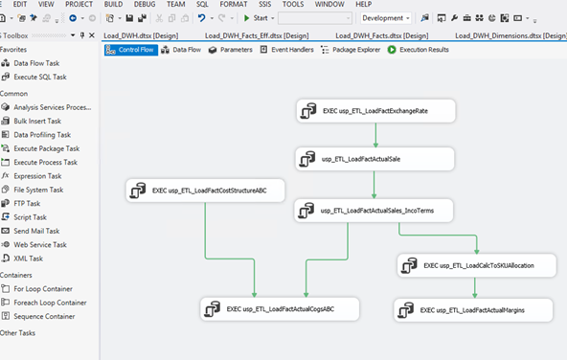
Integration Services (SSIS)
Microsoft Integration Services is a platform for building enterprise-level data integration and data transformations solutions. You use Integration Services to solve complex business problems by copying or downloading files, sending e-mail messages in response to events, updating data warehouses, cleaning and mining data, and managing SQL Server objects and data.

Slide 27
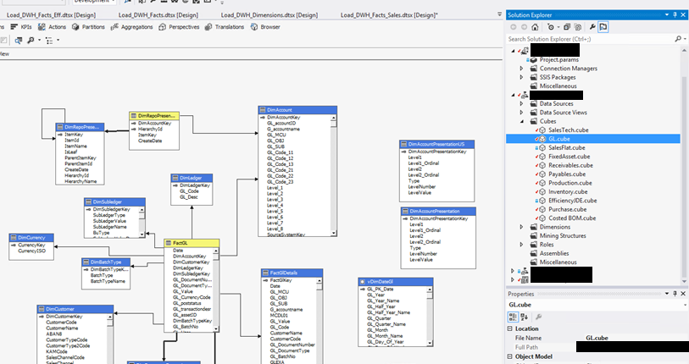
Analysis Services (SSAS)
Analysis Services is an analytical data engine used in decision support and business analytics, providing the analytical data for business reports and client applications such as Power BI, Excel, Reporting Services reports, and other data visualization tools.

Slide 28
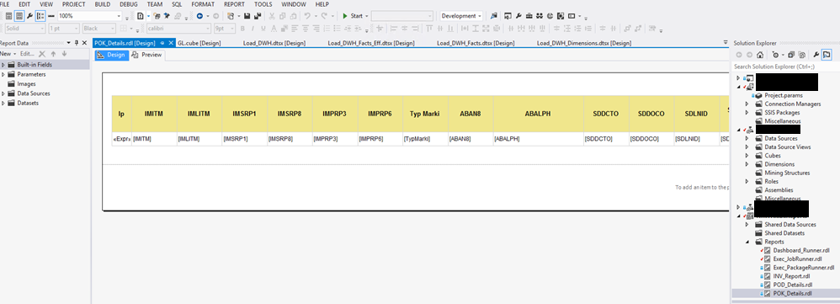
Reporting Services (SSIS)
SQL Server Reporting Services is a solution that customers deploy on their own premises for creating, publishing, and managing reports, then delivering them to the right users in different ways, whether that’s viewing them in web browser, on their mobile device, or as an email in their in-box.

Slide 29
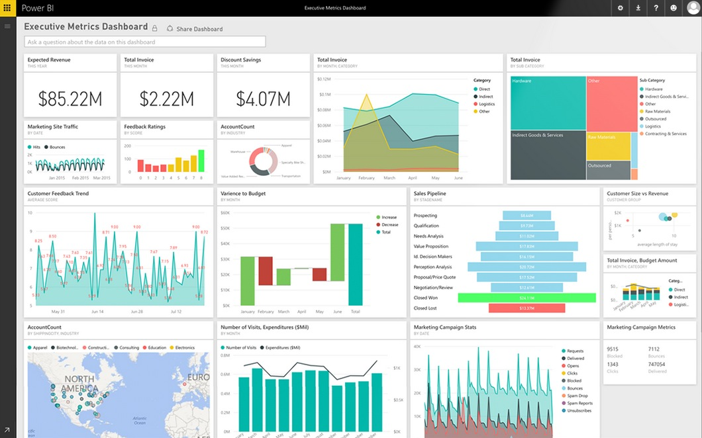
PowerBI
Power BI is a suite of business analytics tools to analyze data and share insights. Power BI dashboards provide a 360-degree view for business users with their most important metrics in one place, updated in real time, and available on all of their devices. With one click, users can explore the data behind their dashboard using intuitive tools that make finding answers easy.

Slide 30
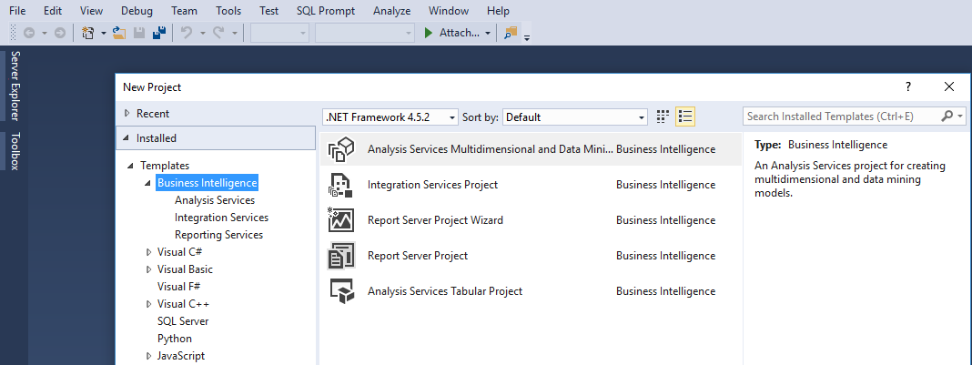
Visual Studio SSDT BI
SQL Server Data Tools is a modern development tool that you can download for free to build SQL Server relational databases, Azure SQL databases, Integration Services packages, Analysis Services data models, and Reporting Services reports. With SSDT, you can design and deploy any SQL Server content type with the same ease as you would develop an application in Visual Studio.

Slide 31
SSAS
Microsoft BI
OLAP
SSIS
DWH
SSRS / PowerBI / Excel …
ETL
Source
Raport / Analiza / Dashboard
SQL Server
SQL Server

Slide 32
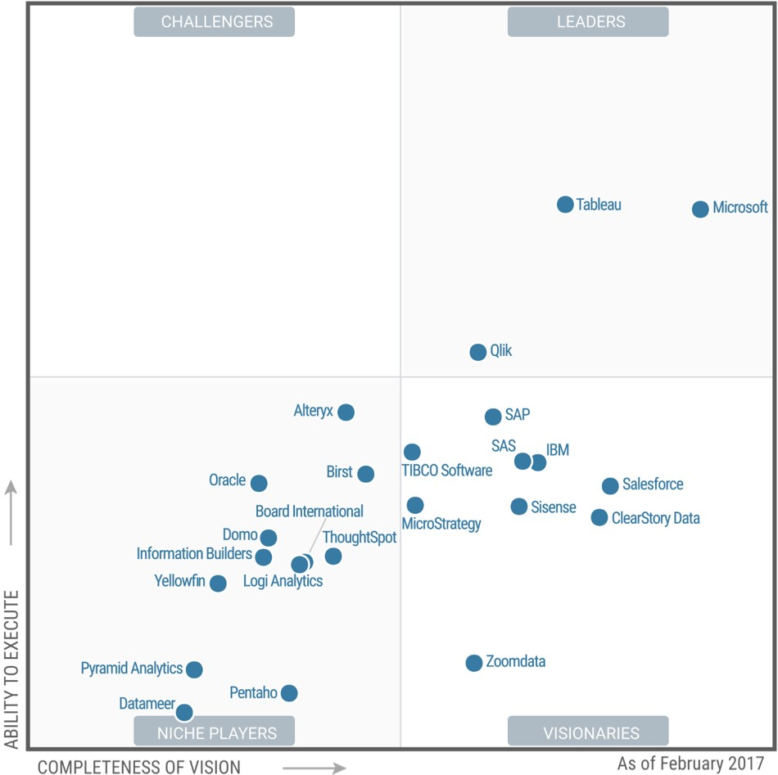
Gartner 2017 Magic Quadrant for Business Intelligence

Slide 33
Zakres przedmiotu
DWH: Teoria, Architektura, Zapytania Analityczne
ETL: Teoria, T-SQL oraz SSIS
DWH
Source
ETL

Slide 34
Linki:
http://searchbusinessanalytics.techtarget.com/definition/business-intelligence-BI
http://edu.pjwstk.edu.pl/wyklady/hur/scb
http://edu.pjwstk.edu.pl/wyklady/szb/scb/
http://tdan.com/data-warehouse-design-inmon-versus-kimball/20300
https://financesonline.com/15-best-business-intelligence-tools-small-big-business/
https://sqldusty.com/2016/05/16/10-sql-server-data-warehouse-design-best-practices-to-follow-part-1/
https://blogs.msdn.microsoft.com/sqlcat/2013/09/16/top-10-best-practices-for-building-a-large-scale-relational-data-warehouse/
http://searchdatamanagement.techtarget.com/feature/The-benefits-of-deploying-a-data-warehouse-platform
http://www.computerweekly.com/tip/Inmon-or-Kimball-Which-approach-is-suitable-for-your-data-warehouse
https://www.xplenty.com/blog/Inmon-vs-Kimball-The-Big-Data-Warehouse-Duel/

